Slide 1
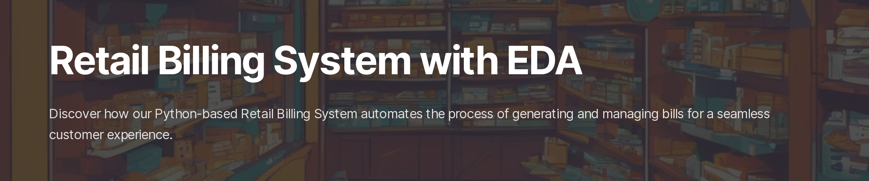
By : 202318006 & 202318033

Slide 2

Introduction :
Welcome to the Retail Billing System Project! This innovative Python-based solution revolutionizes the retail experience by automating transactions and managing diverse product categories. Join us on a journey through seamless billing, automated printing, email communication, and insightful data analysis. Let's explore how this project enhances efficiency and elevates the retail landscape.

Slide 3
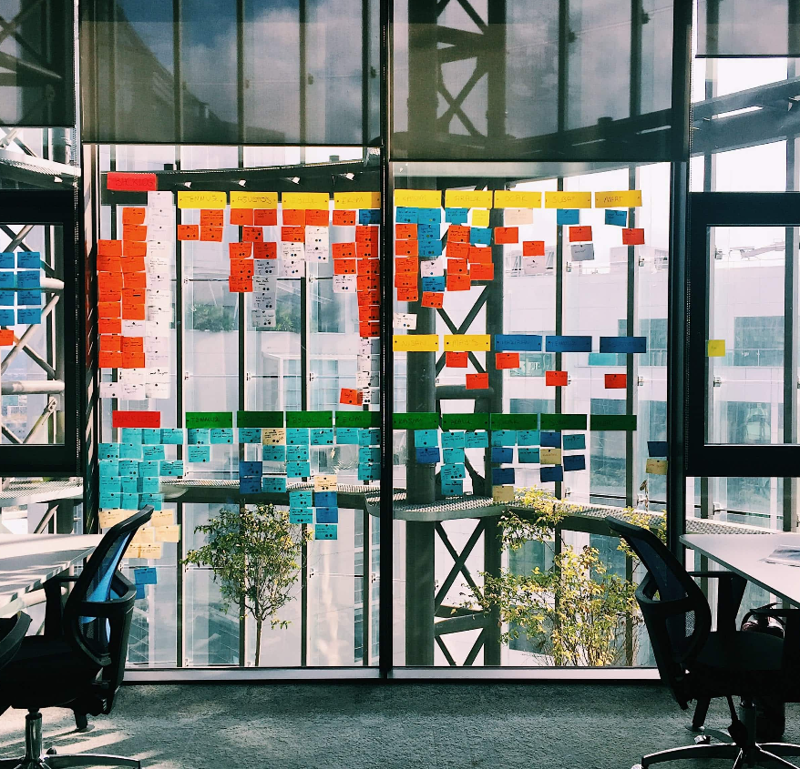
Methodology :
Requirements Analysis
System Design
Implementation
Testing and Validation
Exploratory Data Analysis (EDA)
Documentation and Reporting

Slide 4

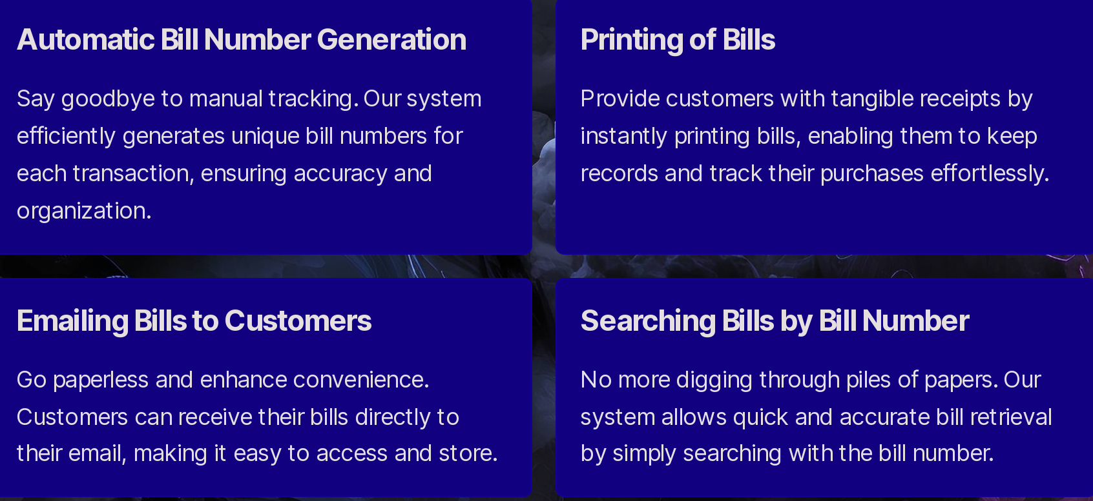
Features of Billing System

Slide 5
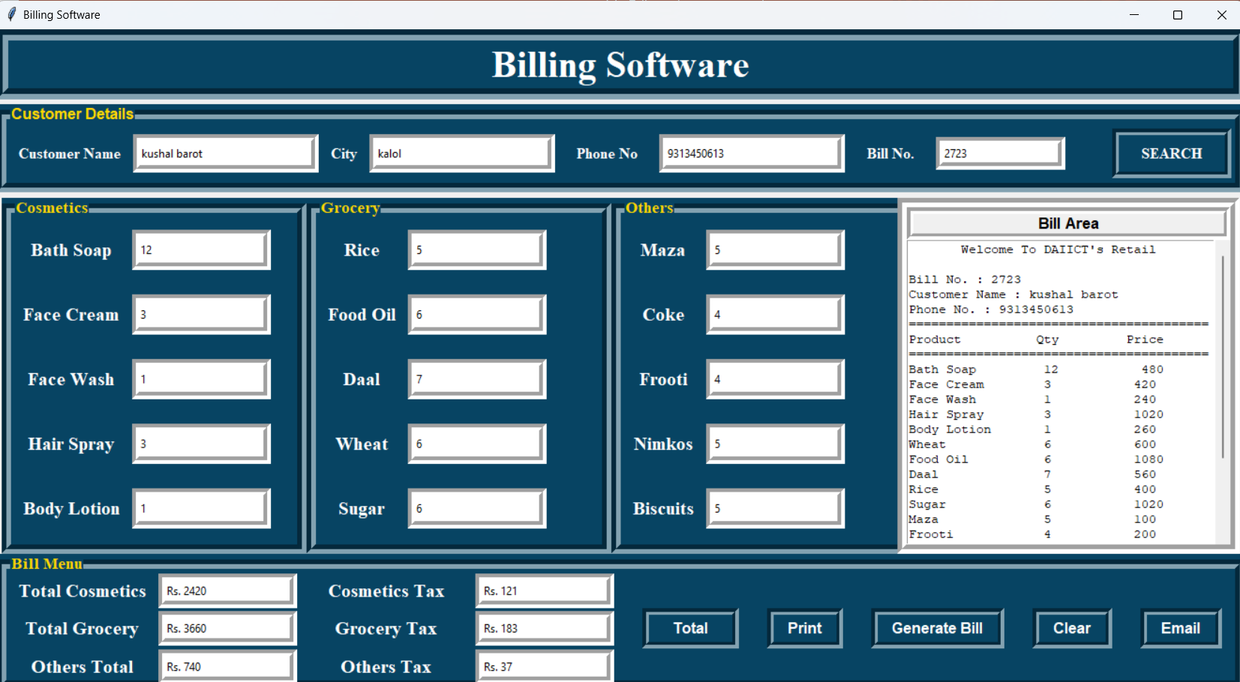

Slide 6
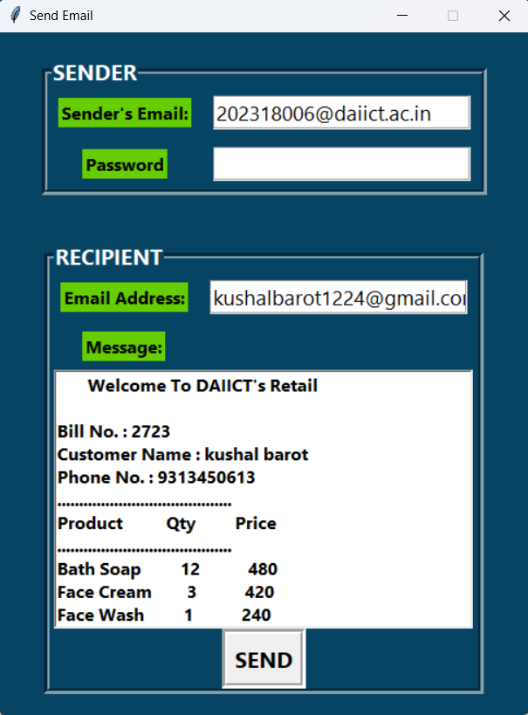
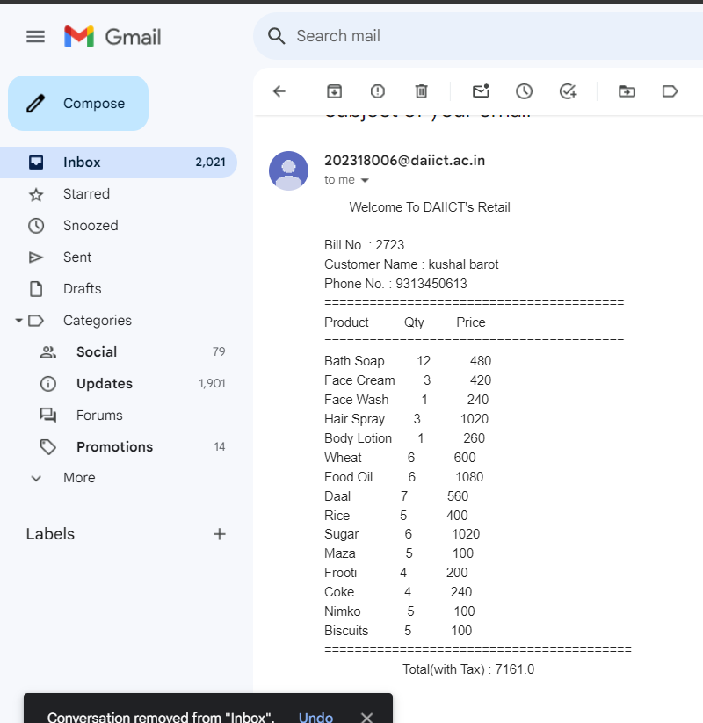

Slide 7
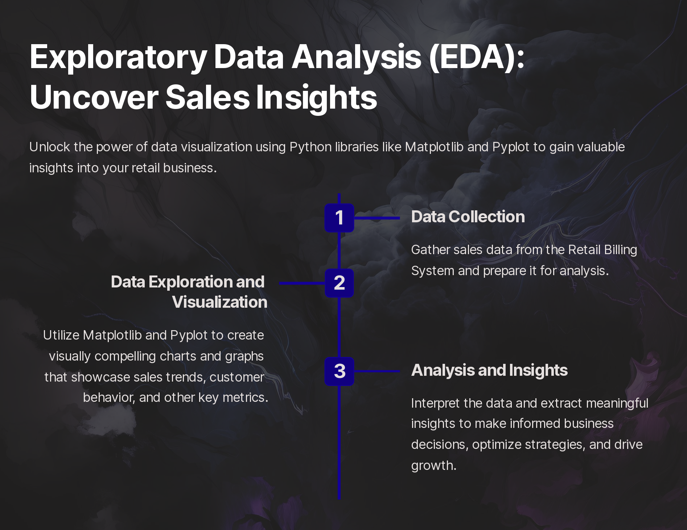

Slide 8
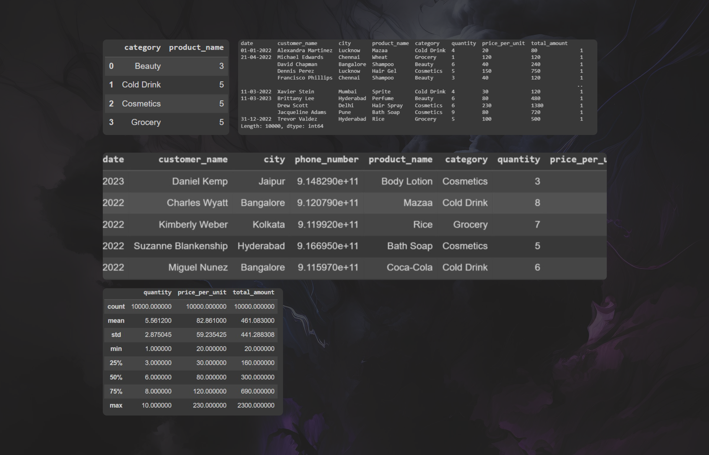
DATASETS

Slide 9
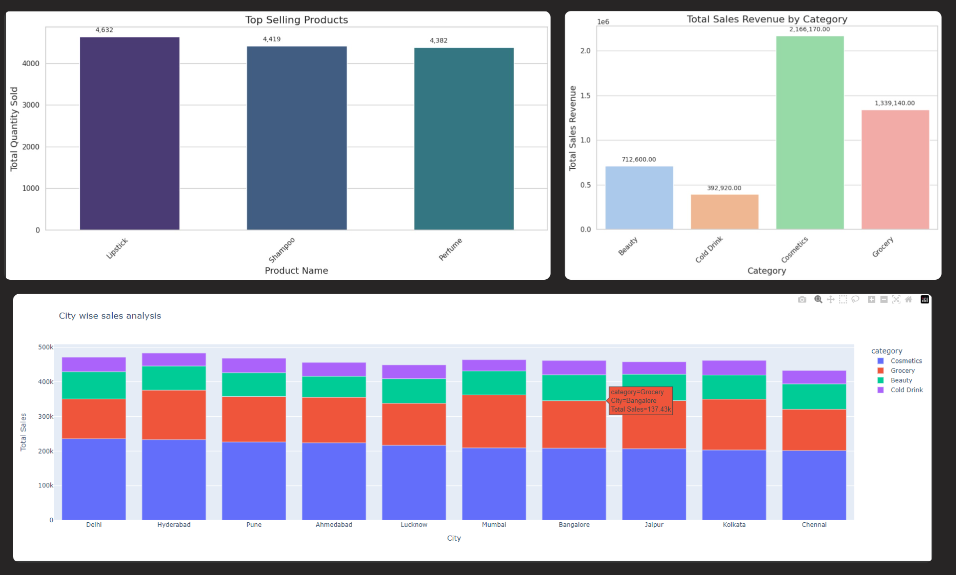
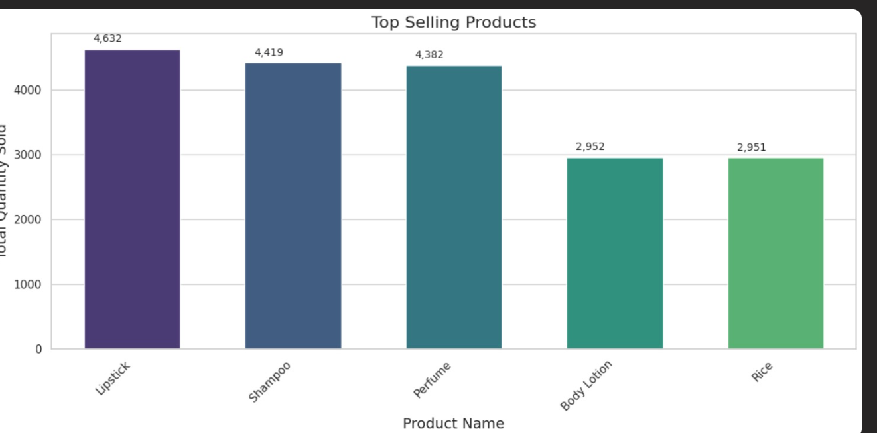
From the provided data, we can make several observations
Cosmetics Category: - Top Performing Cities: Delhi, Hyderabad, Pune
Lowest Performing Cities: Kolkata, Chennai

Slide 10
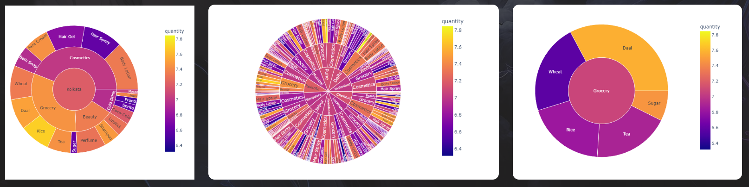
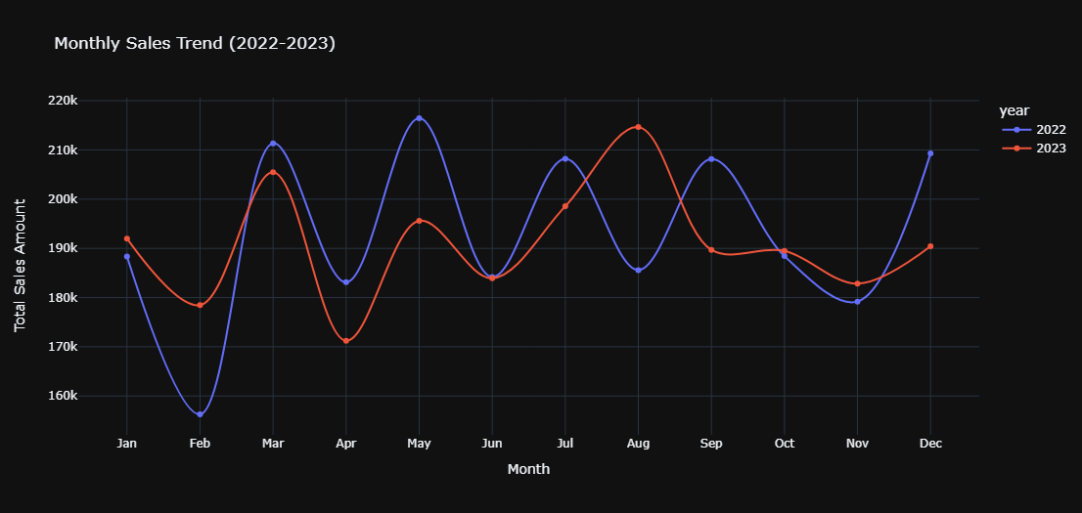
Sales Trend Summary:
There's no big increase or decrease in sales overall.
Important months are May and August—they're important for sales.

Slide 11
Conclusion:
The Retail Billing System successfully streamlined retail transactions through automated billing, integrated product categories, and insightful Exploratory Data Analysis. It incorporates a mailing system for customer bills, enables easy bill retrieval by number, and supports convenient bill printing. This underscores our commitment to innovation in retail management, enhancing efficiency and customer service.

